Slide 1
Microsoft Project 2007
Formatting and Printing Your Project Plan

Slide 2

Course Objectives
Format views
  Format the Gantt Chart view
  Format text in a view
  Draw objects on a Gantt Chart Format and print reports
Formatting and printing reports
  Types of reports.
  Format reports.

Slide 3
Formatting a Gantt Chart View
Displaying the Summary Task of the Project
  Tool → Options → View Tab → “Outline options for” section
  Check “Show project summary task”
Adjust column width
  Double-click the right edge of the Duration column or…
  Double-click anywhere in a column heading, and then in the Column Definition dialog box that appears, click the Best Fit button.
Copy the Gantt Chart view,
  on the View menu, click More Views.
  In the More Views dialog box, click Copy.
  In the View Definition dialog box, in the Name box, type Custom Gantt Chart and then click OK.
  In the More Views dialog box, click Apply.
  On the Standard toolbar, click Scroll to Task.

Slide 4
Formatting a Gantt Chart View
Formatting the Text (Font Size) in the Gantt Chart
  To open the Text Styles dialog box, on the Format menu, click Text Styles.
  In the Size list, select 12,
  Click OK.
Formatting the Gantt Bars (Use Wizard)
  On the Format menu, click Gantt Chart Wizard.
  On the Welcome to the Gantt Chart Wizard page, click Next.
  Under What kind of information do you want to display in your Gantt Chart?, select Other,
  In the drop-down list, select Standard: Style 4, and then click Finish.
  To apply the formatting to the Gantt Chart, click Format It, and then click Exit Wizard.

Slide 5
Formatting Text in a View
Formatting an Individual Gantt Bar
  Select a task in Task Name column
  To format the individual bar, on the Format menu, click Bar.
  In the Format Bar dialog box, on the Bar Shape tab, in the Middle area, in the Colour list, select Blue, and then click OK.
Formatting the Text in the Table
  To open the Text Styles dialog box, on the Format menu, click Text Styles.
  To format the summary tasks, in the Text Styles dialog box, in the Item to Change list, click Summary Tasks.
  In the Size list, select 10, and then in the Color list, select Blue.
  In the Background Color list, select Silver.
  In the Background Pattern list, select the dark dot pattern, which is the last option in the list, and then click OK.

Slide 6
Formatting Text in a View
Apply direct formatting to a specific item
  In the Summary table, in the Cost column, select cost of coding.
  On the Format menu, click Font.
  In the Font dialog box, in the Font style list, select Bold Italic.
  In the Background Color list, select Yellow, and then click OK.
Remove the direct formatting that is applied to text
  Select the cell containing the formatted text, and then on the Edit menu, point to Clear, and click Formats.

Slide 7
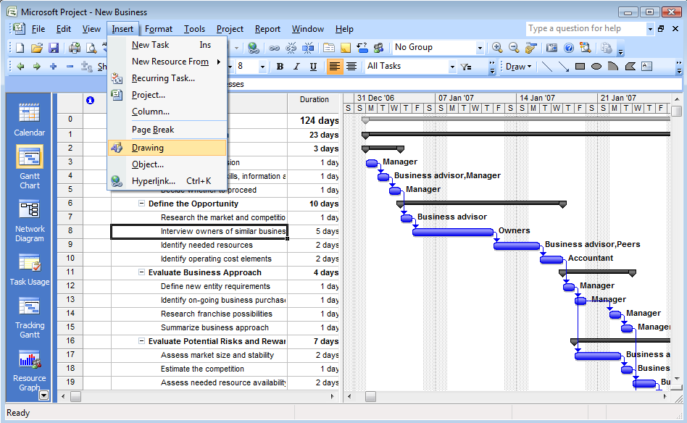
Draw Objects on Gantt Chart

Slide 8
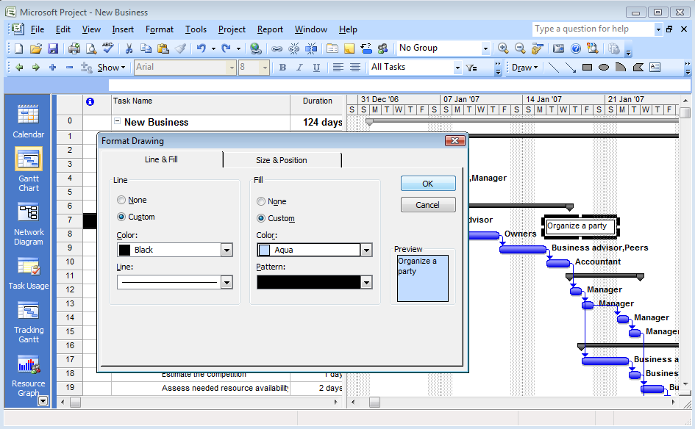
Draw Objects on Gantt Chart
Format → Drawing → Properties

Slide 9
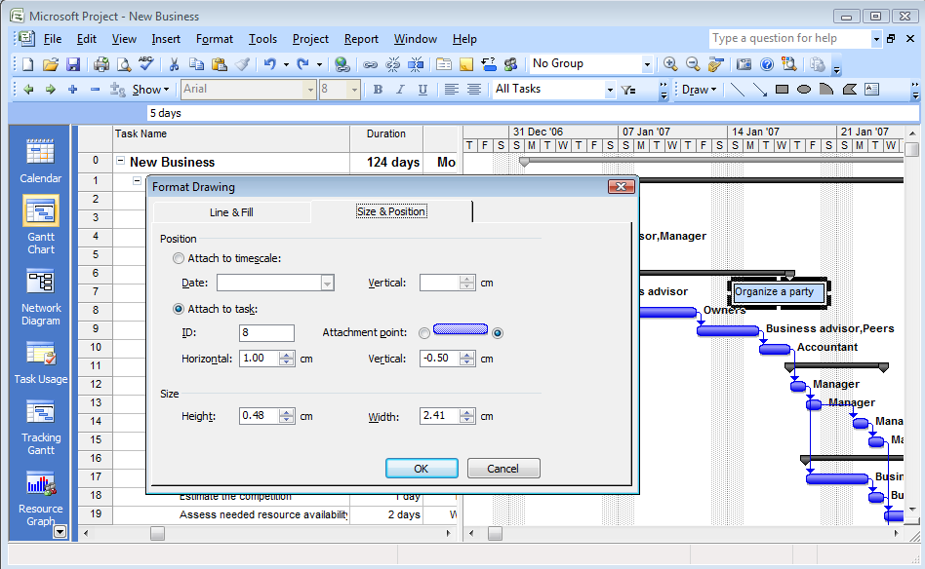
Draw Objects on Gantt Chart

Slide 10
Questions
You have decided to BOLD the cost text in the table to highlight where cost is exceeding the budget. Which one of the following features should you use to format the text?
Select the best answer
  The Font command
  The Bar Styles option
  Gantt Chart Wizard
  ✓

Slide 11
Course Objectives
Format views
  Format the Gantt Chart view
  Format text in a view
  Draw objects on a Gantt Chart Format and print reports
Formatting and printing reports
  Types of reports.
  Format reports.

Slide 12
Formatting and Printing Reports
Project 2007 provides several types of predefined custom reports that help communicating and presenting the information effectively.
You can also specify the format, such as the column totals, gridlines, or borders, for the data in these reports.
Project 2007 helps you integrate these reports with other Office programs and export the data.

Slide 13
Types of Reports
Tabular reports.
  The predefined reports are divided into six categories —
    Overview, Current activities, Costs, Assignments, Workload, Custom reports
Visual reports.
  A visual report consists of interactive tables called PivotTables that summarize or cross-tabulate large amounts of data.
  It helps you rotate the rows and columns of a PivotTable report to view different summaries of the source data, filter the data by displaying different pages, or display further details of the data.
  Visual reports help you select the fields that you want to display and modify the report without having to regenerate it
  You can use visual reports to export data to Microsoft Office Excel and Microsoft Office Visio
  Visual reports are divided into six categories —
    Task usage, resource usage, assignment usage, task summary, resource summary, and assignment summary reports.

Slide 14
Generating a Tabular Report
Generating a Tabular Report
  Open a project plan.
  On the Report menu, click Reports.
  In the Reports dialog box, click Custom, and then click Select. The Custom Reports dialog box lists all the predefined reports
  In the Custom Reports dialog box, under Reports, select Resource (work), and then click Preview.
  On the Print Preview toolbar, click Close.
  In the Custom Reports dialog box, click Close.
  In the Reports dialog box, click Close.

Slide 15
Generating a Tabular Report
Generating a Visual Report (It requires Office Excel)
Open an existing project plan
On the Report menu, click Visual Reports.
In the Visual Reports dialog box, under Show report templates created in, ensure that Microsoft Office Excel is selected and the All tab is visible.
On the All tab, select Resource Remaining Work Report, and then click View. Project 2007 exports the resource data to Office Excel. The chart sheet that is generated in Office Excel contains a stacked bar chart of the actual and the remaining work for each resource. The Resource Summary sheet stores the data that is being used to generate the bar chart.
Close Office Excel. If prompted to save, click No.
In the Visual Reports dialog box, click Close.

Slide 16
Questions
You are a manager of a small GENERAL store. You want to reorganize the store to improve the look. You assign a list of daily tasks to the employees. You need a report that lists the tasks and schedules for each employee. You also plan to post the report on the information board. Which one of the following reports should you use to create the task list?
  Visual report.
  PivotTable report
  Tabular Report
  ✓

Slide 17
Questions
Project 2007 provides many types of reports that you can use to present information. Match the following reports with their correct descriptions.
  Overview report.
  Project Summary report.
  Assignment report.
  Who Does What When report.
  This report provides task-based information.
  This report provides resource assignment information.
  This report provides project-wide overview information.
  This report can be used as a recurring status report with the clients.
1-C, 2-D, 3-B, 4-A

Slide 18
Course Objectives
Format views
  Format the Gantt Chart view
  Format text in a view
  Draw objects on a Gantt Chart Format and print reports
Formatting and printing reports
  Types of reports.
  Format reports.

